Slide 1

ARDUSCOPE
Lab Training
Complex Embedded Systems
-Project-
Students:
Matei Adrian Vidican
Sergii Skoblikov

Slide 2
Initial request for the oscilloscope
2 channels
Display the measured values graphically on the TFT-shield
Time scale
Voltage scale
Labels
Auto-scaling functions
Warning messeges
Reasonable configurability

Slide 3
Required Hardware parts
Arduino UNO
TFT display with its on graphical processor (to have a good refresh rates, speed for data acquisition and to save flash memory )
Digital encoders and pushbuttons
Wires, probes
For conversion of the signal:
  Case 1: Build-in Arduino ADC convertor
  Case 2: Precision Sample and Hold Amplifier IC
  Case 3: Dedicated ADC IC

Slide 4
Software features to be implemented
Selection of the inputs (both on/ch1 only/ch2 only)
Graphical display of the signal
Time scale\Voltage scale\Labels
Time/Voltage offset
Auto-scaling functions
One-shot/interleaved acquisition modes
Different measurements of the signal ( frequency, voltage peak to peak, etc.)
Trigger modes (external, internal)
Warning messages (to be clarified...)

Slide 5
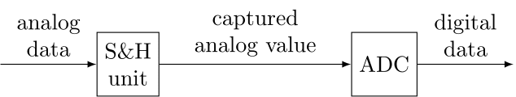
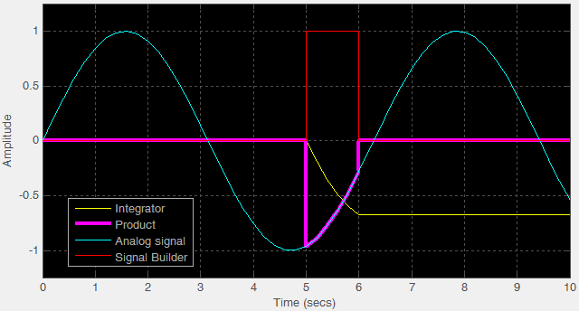
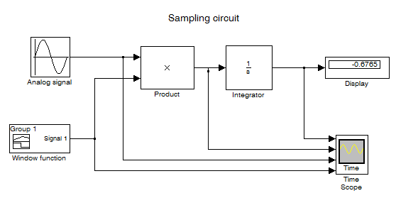
Analog measurement principle

Slide 6
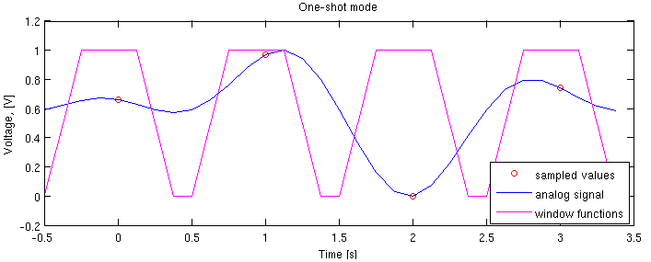
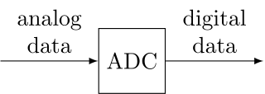
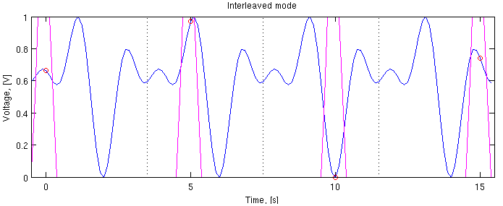
Acquisition modes

